Slide 1


Finding happiness in innovation
DATA 101 Fall 2025
Final Project - R. Miranda

Slide 2
Background
Countries that innovate more in science and technology usually attain higher standards of living.
Thus, the perception is that the countries that innovate more must have happier citizens.
But… does more happiness lead to more innovation??
What are the characteristics of countries that become scientific and technological innovators? Are they the happiest?
PCA was used to understand and explain the role of multiple variables.

Slide 3
Measurable indicators
From the World Bank: 21 variables
Country infrastructure: electricity, power consumption, internet servers, internet use by population
Research and advanced manufacturing: R&D expenditure, high-tech manufacturing value added, foreign direct investment
Human capital: health expenditure, life expectancy, education expenditure, completed sec. education, unemployed with advanced education
Knowledge output: researchers, patent applications, scientific journal particles, high-tech exports, ICT service exports
National effectiveness: GDP, GDP/person/employed, GNI/capita, adj. net national income
From the World Intellectual Property Office: 1 variable
Global innovation index (150 countries since 2011 (0-100)
From Gallup World Poll: 1 variable
Happinness index (145 countries since 2011) (0-10)
Dataset contains 5425 records, reduced after cleaning.

Slide 4
Approach
Cleaned and reduced dataset to 2016 rows.
EDA.
Split dataset into training (80%) and testing (20%) sets.
Did PCA on the 23-variable training dataset.
Assess accuracy and statistical significance of the PCA with the test set.
Interpreted the meaning of the PCAs.
Developed linear regression model for
innovation ~ PC1-PC5 + happiness

Slide 5
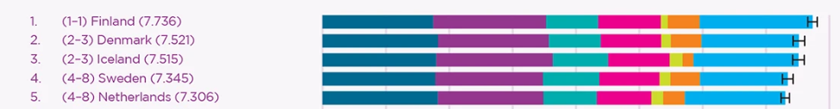

From World Happiness Report

Slide 6
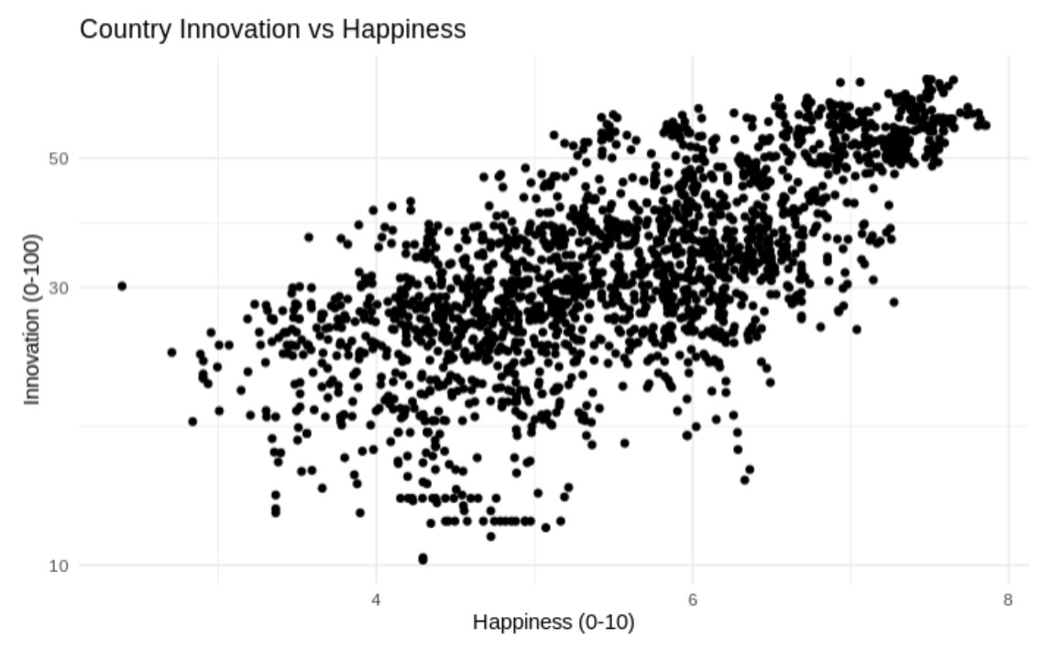
Exploratory data analysis

Slide 7
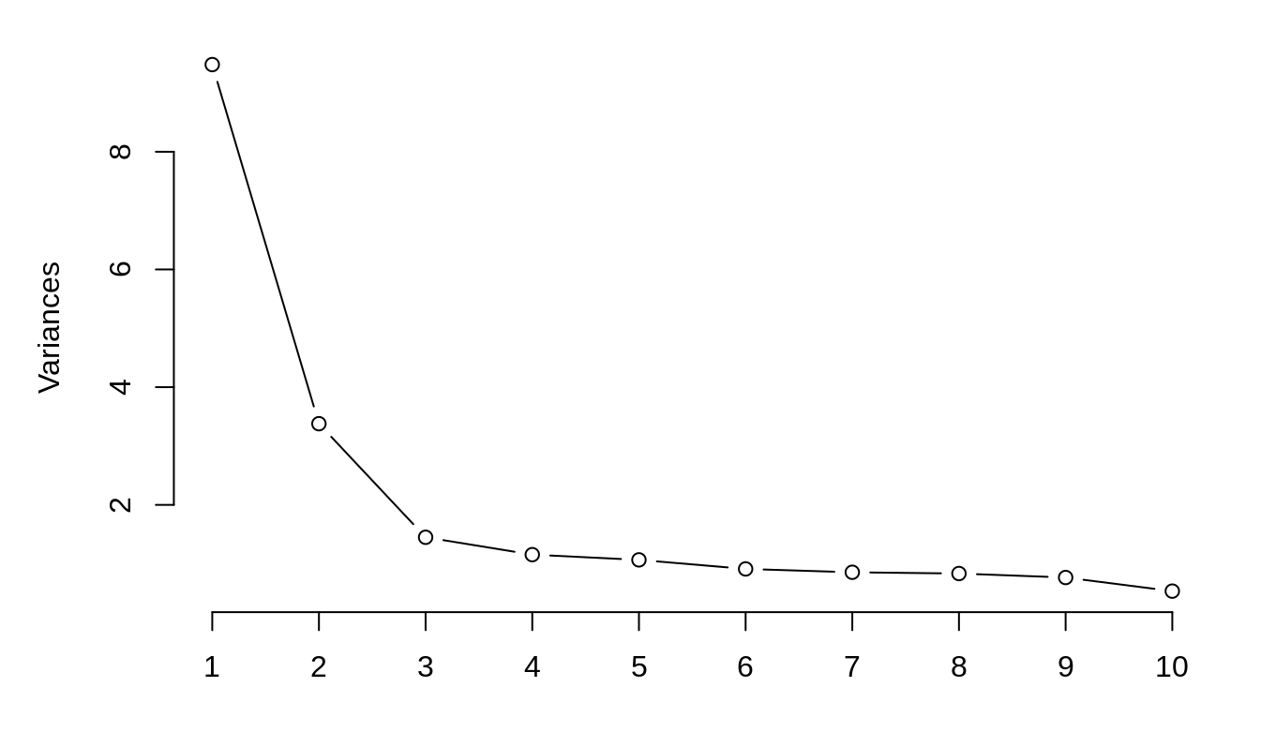
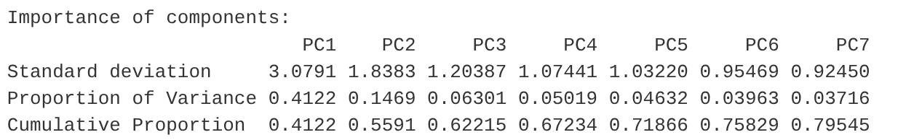
PCA
Spree plot
Kaiser criterion: 1 SD

Slide 8
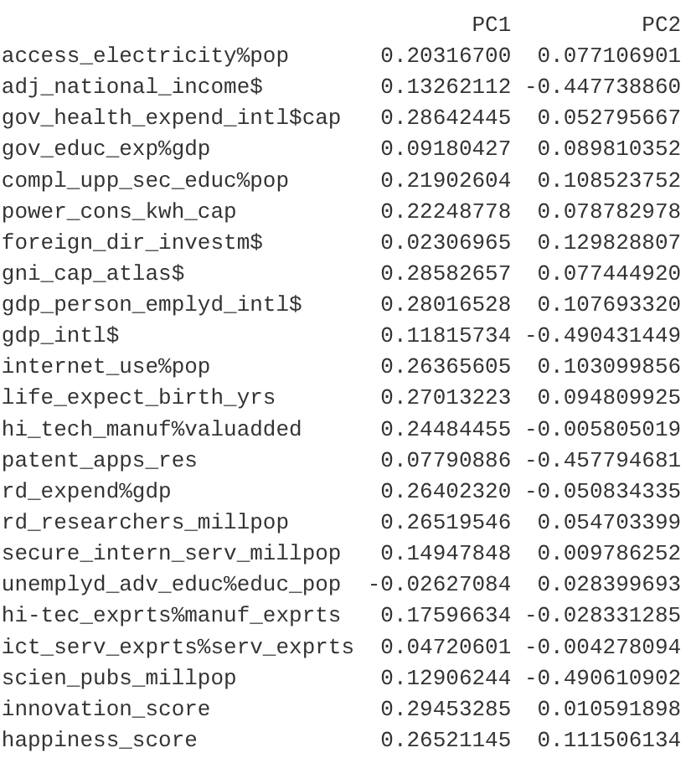
Loadings (rotation matrix)
PC1: country socioeconomic, scientific and technological balance
PC2: (- axis) high productivity, income, scientific outcome, counteracted by (+ axis) social factors

Slide 9
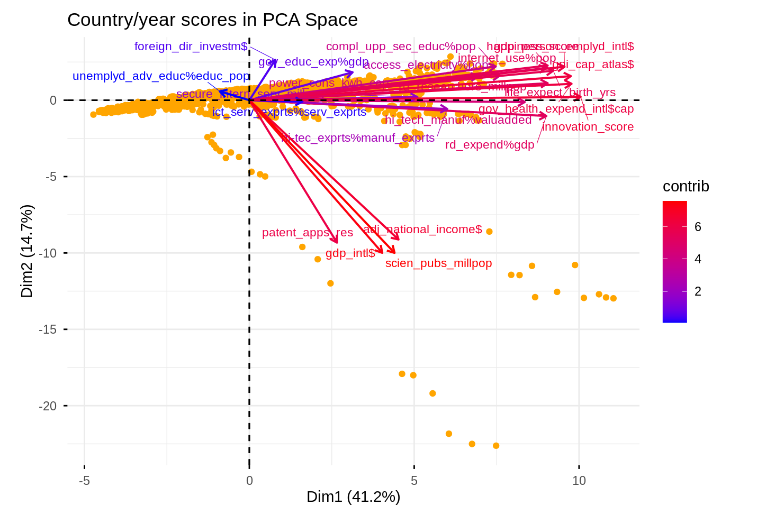
BIPLOT (PC1-PC2) loadings and scores

Slide 10
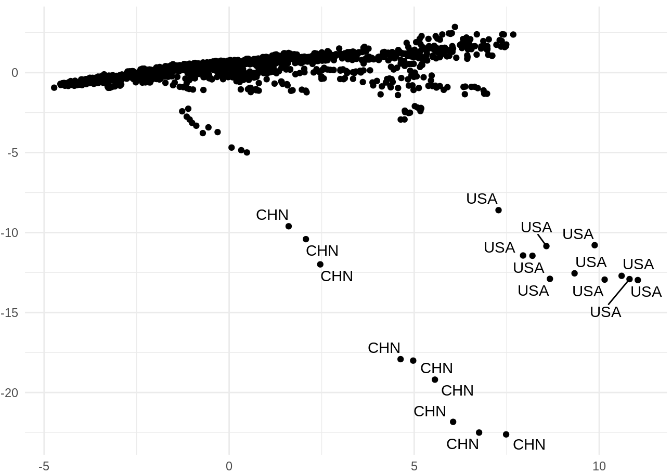
Which are the most competitive countries

Slide 11
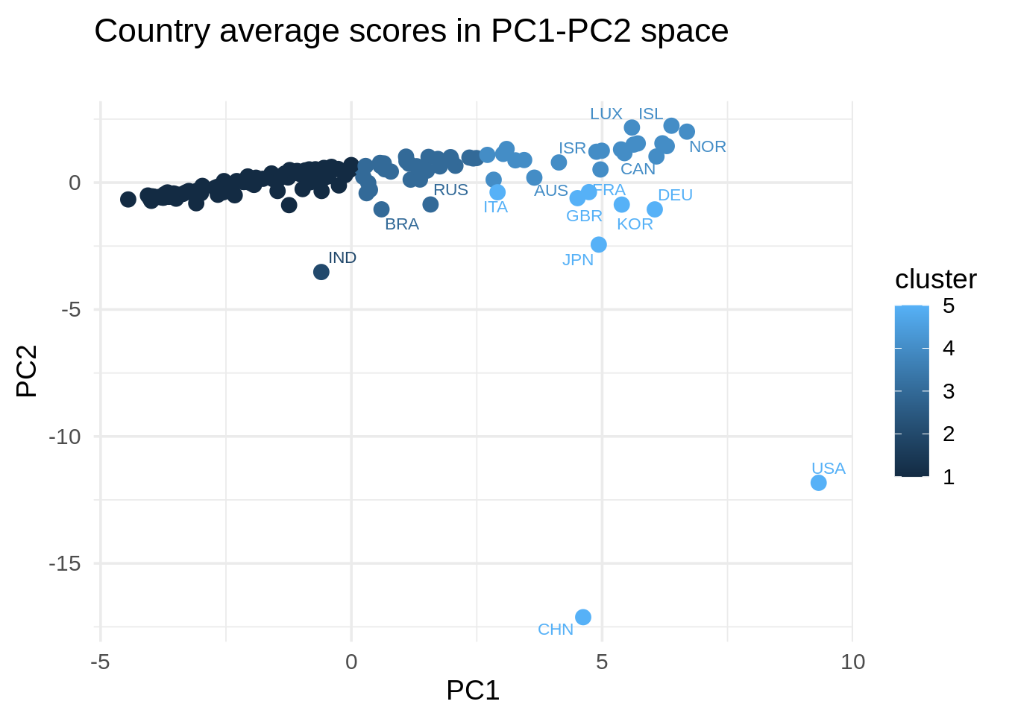
Which are the most competitive countries

Slide 12
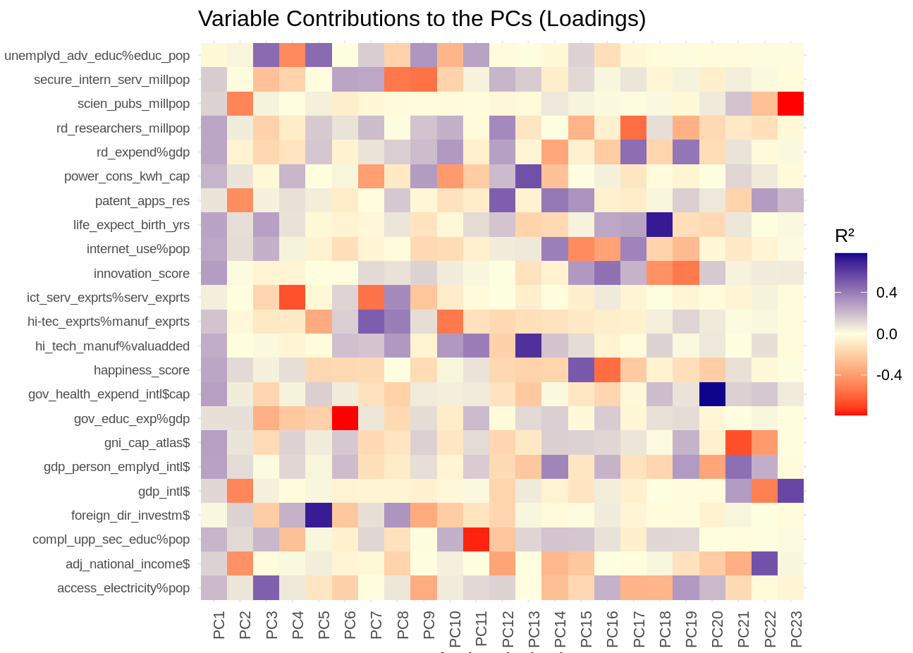

Slide 13
SUMMARY of PC1-PC5 meaning
Meaning of PC1: indicates degree of economic, scientific, technological, and societal access. Countries-years with high PC1 have high GDP per capita, excellent education, high level of innovation, and high scientific productivity and technological impact. Examples are western European, north American and Asean countries
Meaning of PC2: contrasts countries-years according to economic size and scientific/technological output. For example, distinguishes Switzerland from USA, both with high technological output, but of drastically different economic size. Large negative PC2 identifies the largest economies with the leading technologies, like USA and China.
Meaning of PC3: contrasts countries-years with strong social policies (positive loadings) from those with strong promotion for technology (negative loadings)
Meaning of PC4: captures the difference between countries-years that export much information technologies (negative loadings) from those that invest in heavy industry (positive loadings). Examples are eastern European, Russia, and some east Asian countries.
Meaning of PC5: captures the emphasis between countries-years of strong foreign direct investment (positive) against those focused on exports of high-tech products (negative). Examples exist in some of the smaller economies and developing countries like Brazil and Taiwan.

Slide 14
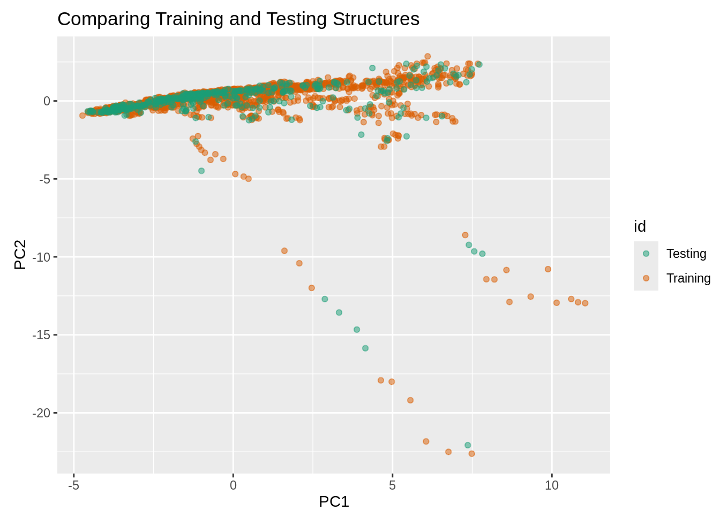
Visual assessment of generalizability (using Testing data)

Slide 15
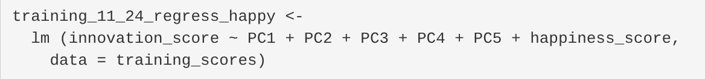
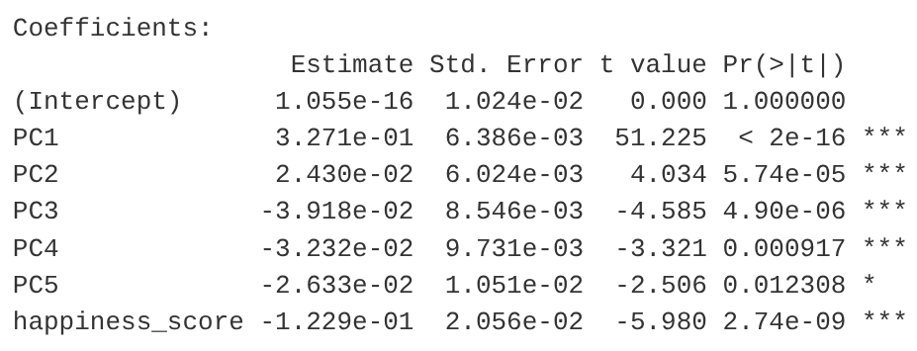
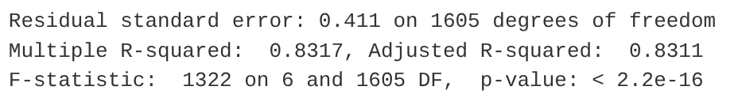
Linear regression of on PC1-PC5 and happiness_score

Slide 16


From World Happiness Report

Slide 17
CONCLUSIONS
PCA allowed us to reduce dimension from 23 variables to 5 PCs and verify generalizability of the training model with a testing dataset.
The interpretation of the PCs allowed us to understand the scores and the country location in PC1-PC2 space.
The linear regression on innovation_score using the 5 PCs and happiness_score as independent variables yields statistically significant model and coefficients.
Happiness influences positively the innovation potential of less developed countries, but in a slightly negative way for countries that have achieved high level of techno-economic development.

Slide 18
NEXT STEPS
Def. Innovation Potential= predicted innovation_score - actual innovation_score.
Countries with positive innovation potential: under-performers.
Countries with negative innovation potential: over-performers.
Classify countries according to Innovation Potential, identify causes (sensitivity analysis) and postulate techno-economic growth models.

